Slide 1
IncomeNet
By Aaron Taflinger

Slide 2
System Description
Project is a simple webpage where users are able to view charts about the rise and fall of Income over the years
Users can view income charts all the way back from 2000
Users can upload their own income and implement it into the database
Users can extract datasets if they choose too
Users can also view the inflation and interest rates along with the income charts

Slide 3
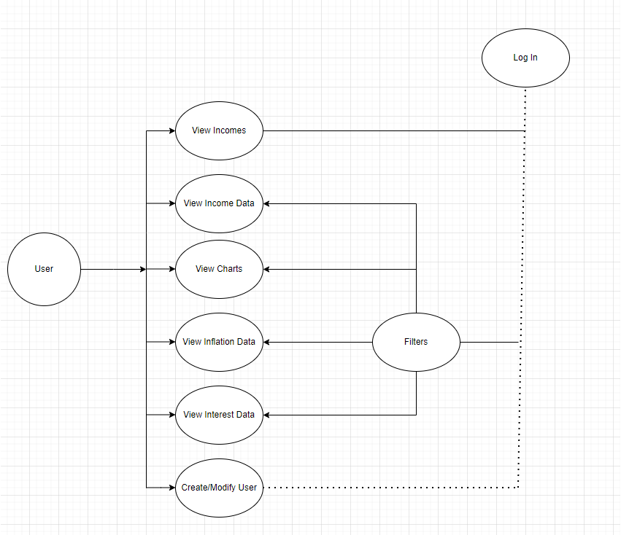
Use Case Diagram

Slide 4
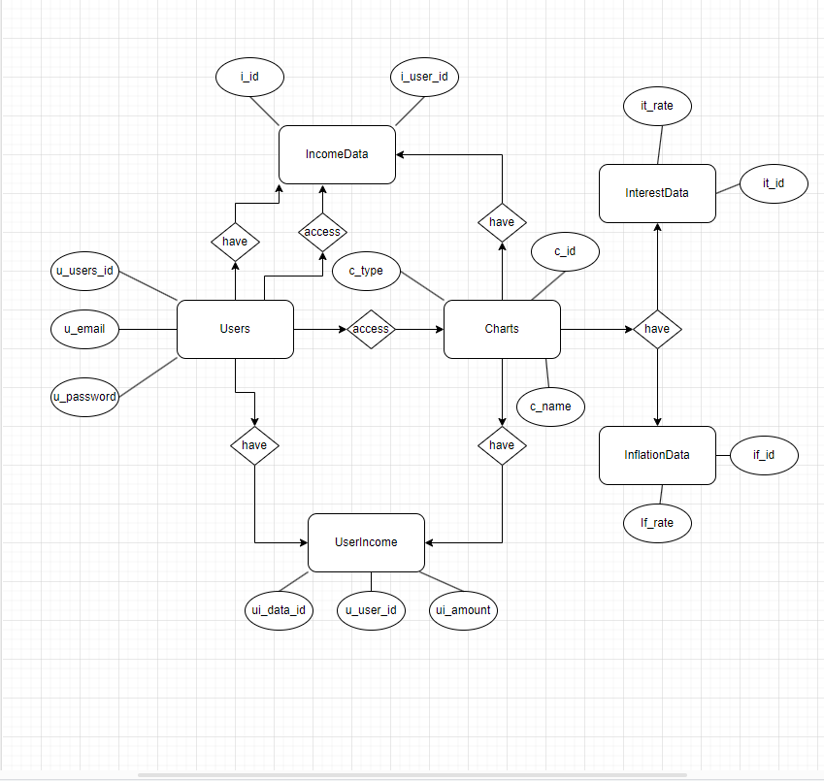
E/R Diagram

Slide 5
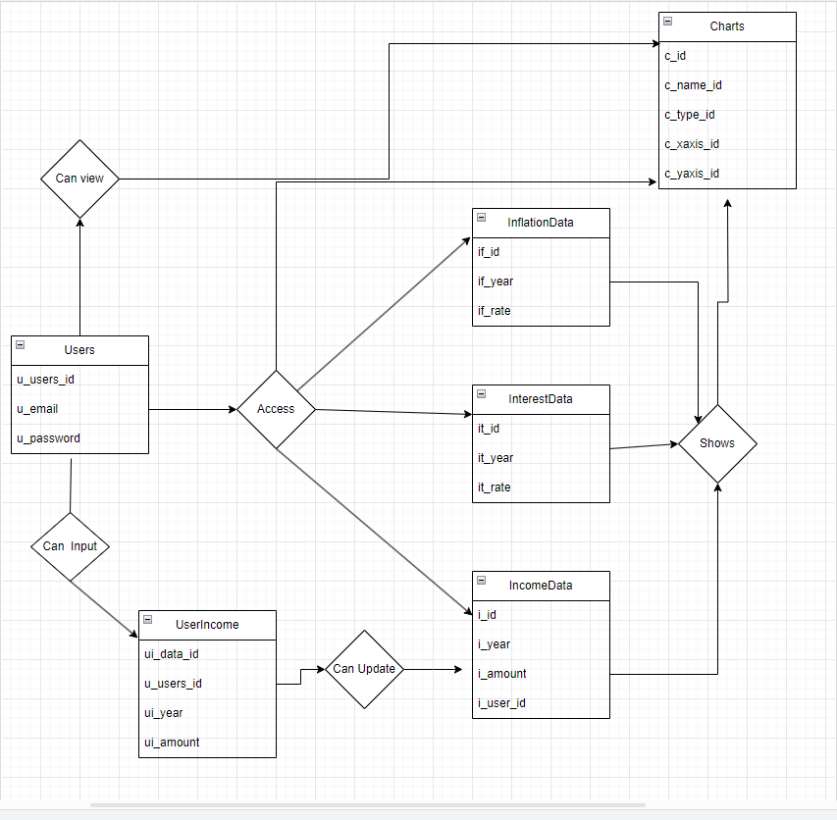
Relational Schema

Slide 6
Environment / Languages
Node.js
  Gives server side connections which allows us to connect with sqlite database
Javascript
  Html function
SQLite3
  Database function
Express
  Server Side API connections

